Slide 1
CELL INJURY Lecture Dr. Safinaz

Slide 2
Introduction
Goals of this presentation……
•To be a guide to key features of cell injury/death and apoptosis
•Outline causes and pathogenesis of cell injury/death and apoptosis
•Describe the morphological changes of cell injury/death and apoptosis

Slide 3
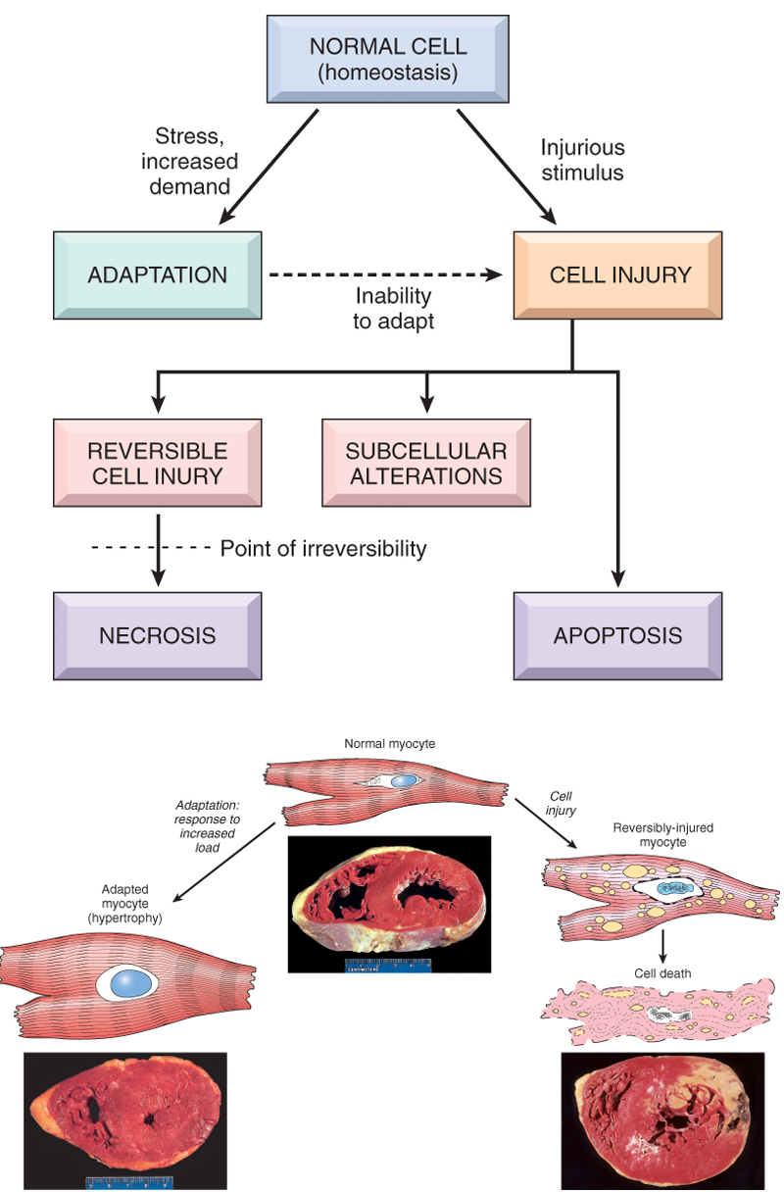

Slide 4
Introduction
General considerations……
Cell injury is part of a continuum
•Degree of injury is a function of
–Injury: type, duration, severity
–Cell: type, status, adaptability

Slide 5
Causes of cell injury
•Hypoxia
•Chemical
•Physical
•Infection
•Immune
•Nutritional (deficiency or excess)
Genetic
Aging

Slide 6
Types of insult –Hypoxia (reduced oxygen)
•Ischemia
–Local
–Systemic
•Hypoxemia
–Inspired oxygen too low
–Diffusion barrier abnormal
–Insufficient carrying capacity in blood
•Interference with oxidative phosphorylation
–e.g. cyanide poisoning

Slide 7
Types of insult -chemical
•Drugs
–e.g. paracetamol overdose
•Many more
–e.g. alcohol, cigarette smoke

Slide 8
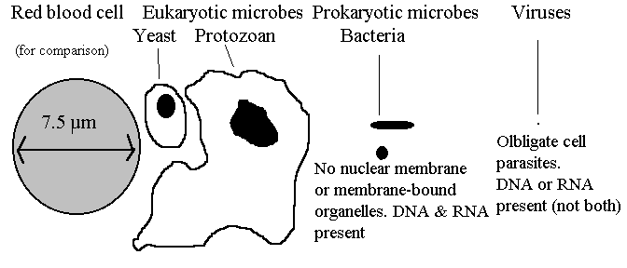
Types of insult -infections
Eukaryotes –Fungi, Protozoa
•Prokaryotes –Bacteria, Rickettsia, Chlamydia
•Viruses –DNA, RNA

Slide 9
Types of insult -Physical
Direct Physical Effects
-extreme heat or cold results
-Sudden changes in pressure
-Electrical currents

Slide 10
Types of insult –immune
Humoral
•Cell-mediated

Slide 11
Types of insult -nutrition
Dietary insufficiency
•Dietary excess

Slide 12
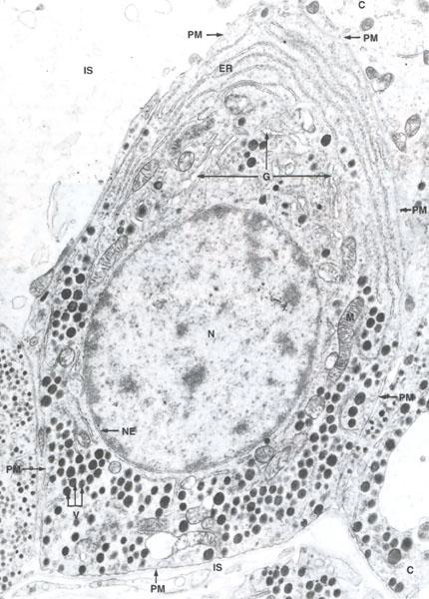
Principle structural targets for cell damage
Cell membranes
–Plasma membrane
–Organellar membranes
•DNA
•Proteins
–Structural
–Enzymes
•Mitochondria
–oxidative phosphorylation

Slide 13
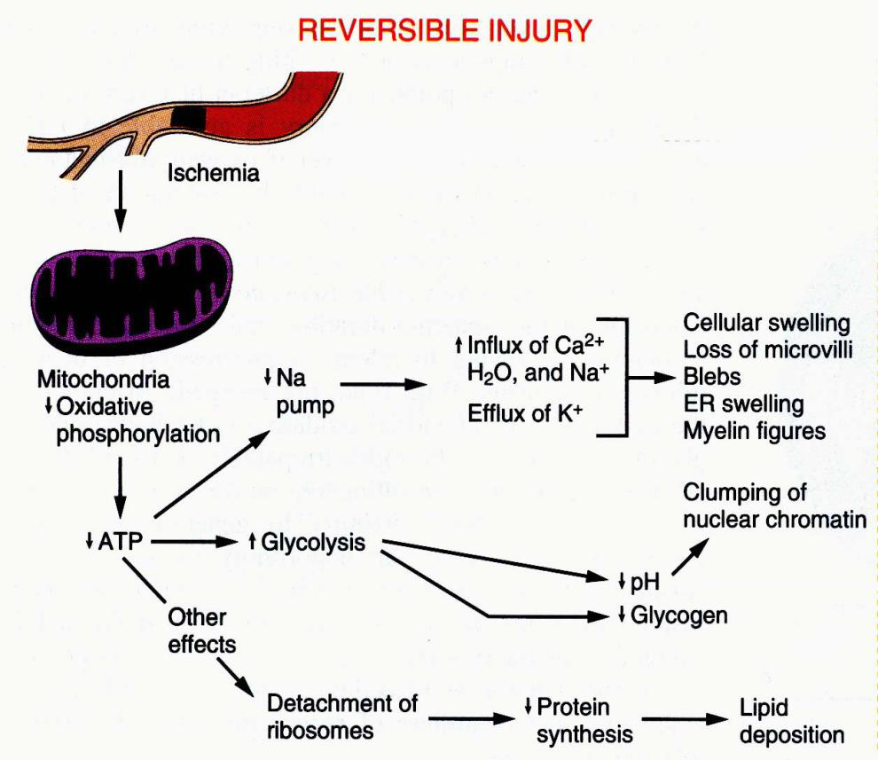
Pathogenesis of cell injury -hypoxia
Reversible
–Loss of ATP
•Failure of Na/K pump
lead cell swelling
–Anaerobic metabolism
•Increased lactic acid
and phosphate lead
clumped nuclear chromatin
–Reduced protein synthesis
•Altered metabolism lead
abnormal accumulations

Slide 14
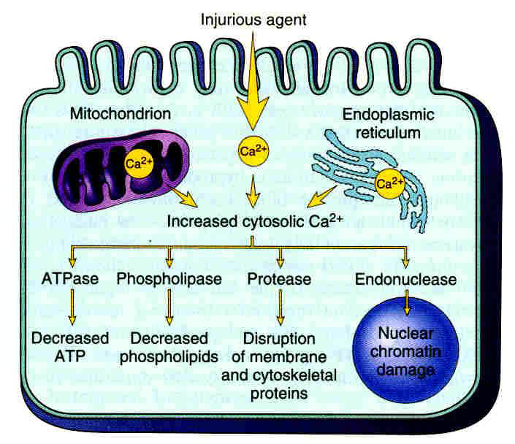
Pathogenesis of cell injury -hypoxia
Irreversible
–Massive intra-cytoplasmic calcium accumulation
–Activation of multiple degradative enzymes
–Lethal cell damage

Slide 15
Pathogenesis of cell injury –non-ischaemic
Reduced ATP synthesis/mitochondrial damage
•Loss of calcium homeostasis
•Disrupted membrane permeability
•Free radicals

Slide 16
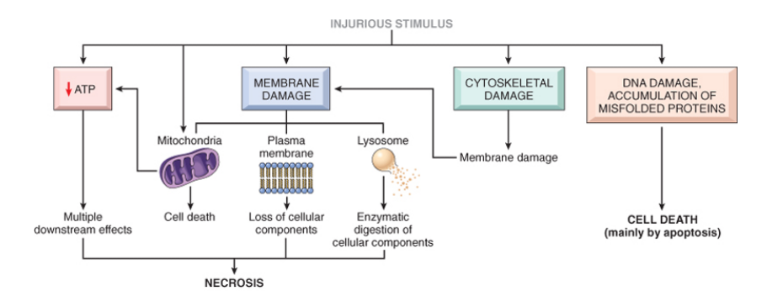

Slide 17
Free radicals
Highly reactive, unstable chemicals
•Associated with cell injury in many settings
–Chemicals/drugs, reperfusion injury, inflammation, irradiation, oxygen toxicity, carcinogenesis

Slide 18
Free radicals
Free radical generation occurs by….
–Absorption of irradiation
–Endogenous normal metabolic reactions
–Transition metals
–Exogenous toxins

Slide 19
Free radicals
Free radicals are removed by….
–Spontaneous decay
–Anti-oxidants
•E.g. Vitamin E, vitamin A, ascorbic acid, glutathione
–Storage proteins
•e.g. transferrin , ferritin
–Enzymes
•Catalase, superoxide dismutase, glutathione peroxidase

Slide 20
Free radicals
Injure cells by…..
–Membrane lipid peroxidation
–Interaction with protein
–DNA damage

